Slide 1

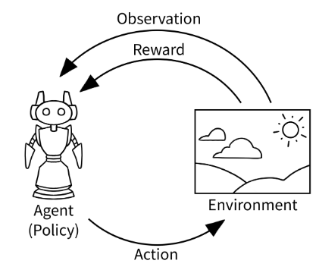

CSC485B Machine Learning for Robotics
SUNY Plattsburgh
Dr. Ned Lecky
Class 20: More RL

Slide 2
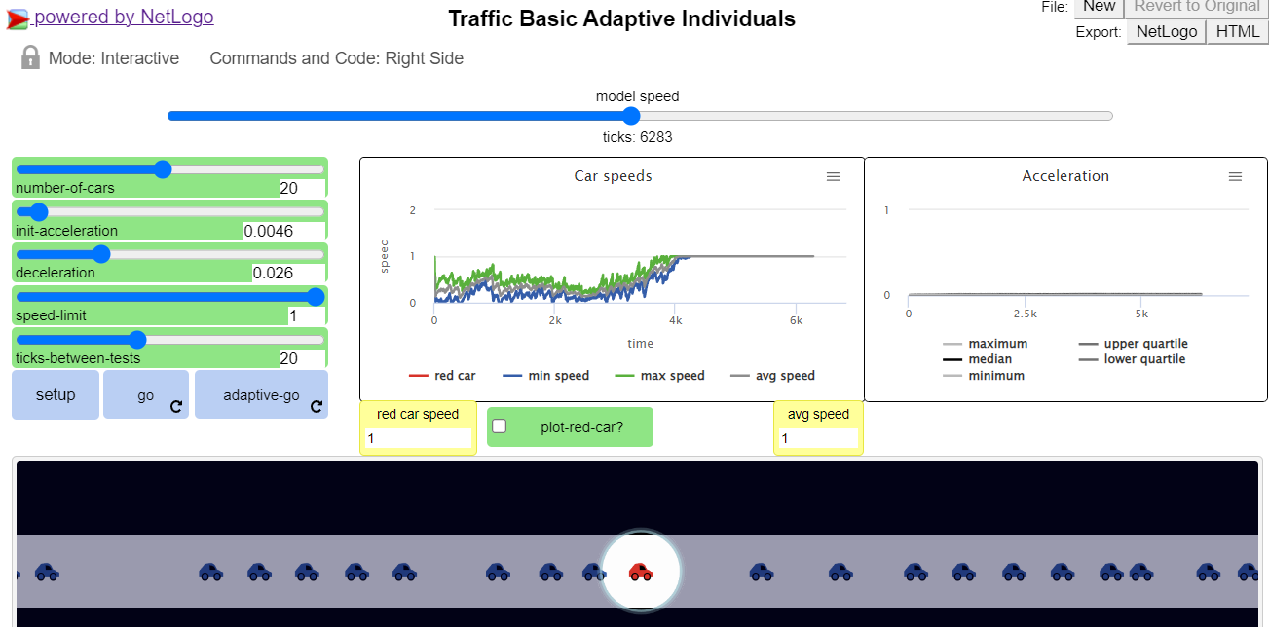
Briefly: More NetLogo
Let’s take a look at
http://www.netlogoweb.org/launch#http://www.netlogoweb.org/assets/modelslib/IABM%20Textbook/chapter%205/Traffic%20Basic%20Adaptive%20Individuals.nlogo
This is much more sophisticated and still ONLY 120 LINES OF CODE!!!!

Slide 3
Continuing Géron Chapter 18
import random
def basic_policy(obs):
angle = obs[2]
# Original mean 41 max 63
#return 0 if angle < 0 else 1 # 41 63
# Tweak mean 43 max 72
#if angle < 0.01:
# return 0
#if angle > -0.01:
# return 1
#return random.randint(0,1)
# Pure random mean 22 max 101
return random.randint(0,1)
# Other thoughts??
#Lookup Tables?????
We saw the crude control time
How about experimenting with the policy?
https://github.com/ageron/handson-ml3/blob/main/18_reinforcement_learning.ipynb

Slide 4
Tracking the best result
totals = []
best_reward = 0
best_seed = 0
for episode in range(500):
episode_rewards = 0
obs, info = env.reset(seed=episode)
for step in range(200):
action = basic_policy(obs)
obs, reward, done, truncated, info = env.step(action)
episode_rewards += reward
if episode_rewards > best_reward:
best_reward = episode_rewards
best_seed = episode
if done or truncated:
break
totals.append(episode_rewards)
print(f'best_reward={best_reward} seed={best_seed}')
np.mean(totals), np.std(totals), min(totals), max(totals)
And to plot, just use best_seed in the plotting code!

Slide 5

Now We Use ML!!!!
Not yet. Our author does and the results are interesting, but
we’re missing out on trying other techniques that might be simpler
Like what?
How about a PID controller!

Slide 6
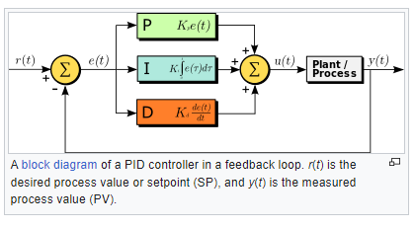
What IS a PID Controller?
https://en.wikipedia.org/wiki/PID_controller
These are ubiquitous but have some problems
P, I, and D can be tricky to set- they strongly interact
The also may not be constant in real world problems
Time-varying
Temperature varying

Slide 7

Classical PID control
First thing I would try is a PD controller (KI = 0)
angle = obs[2]
dangle = obs[3]
KP = 0.1 # Guess
KD = 0.1 # Guess
return 0 if KP * angle + KD * dangle < 0 else 1
Let’s give it a shot!

Slide 8
So a Really Cool Project could be…
Use a NN to compute a set the values of P, I, and D!
How would we proceed?
ChatGPT
Can you use machine learning to set the gain values of a PID controller?
Can you show me an example in PyTorch?
This is a great example of how we can use example code and experimentation to get an idea and then see if we can get some help from the Internet to get started

